Slide 1
CALIPSO-CloudSat
2006 - 2016
Celebrating 10 years of operations and science

Slide 2
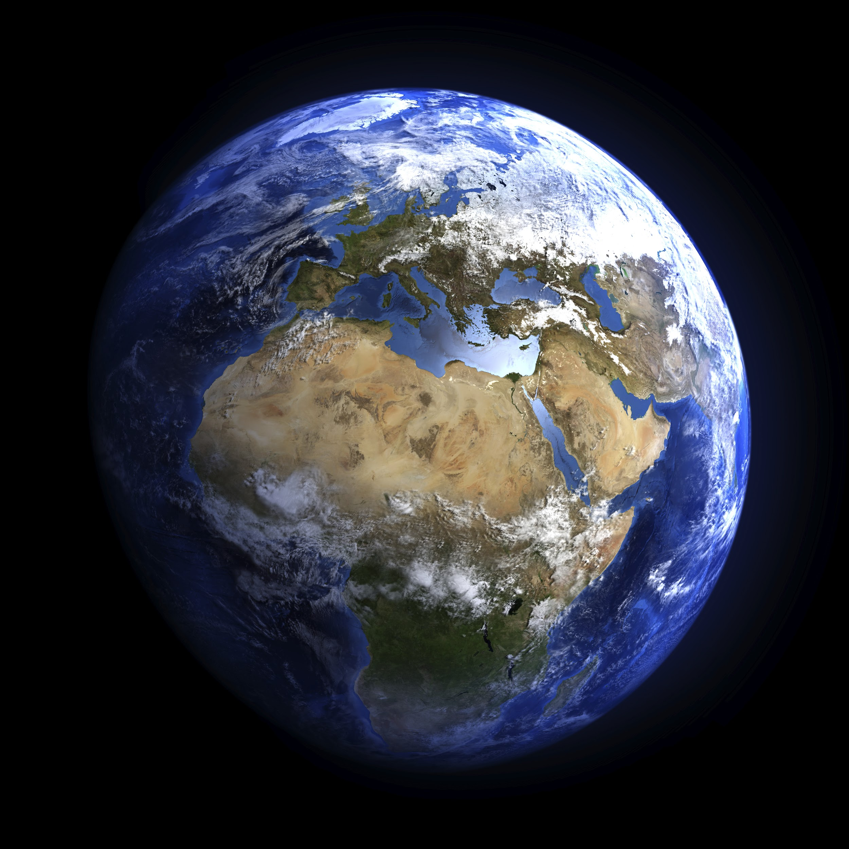
Notes:
2

Slide 3
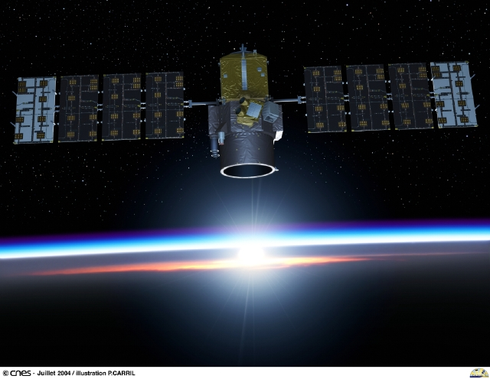
Notes:
4

Slide 4
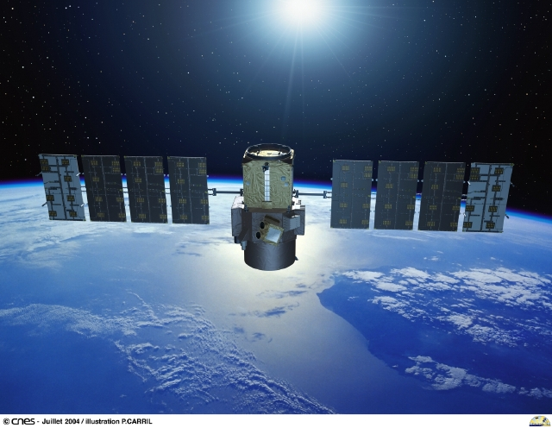
Notes:
3

Slide 5
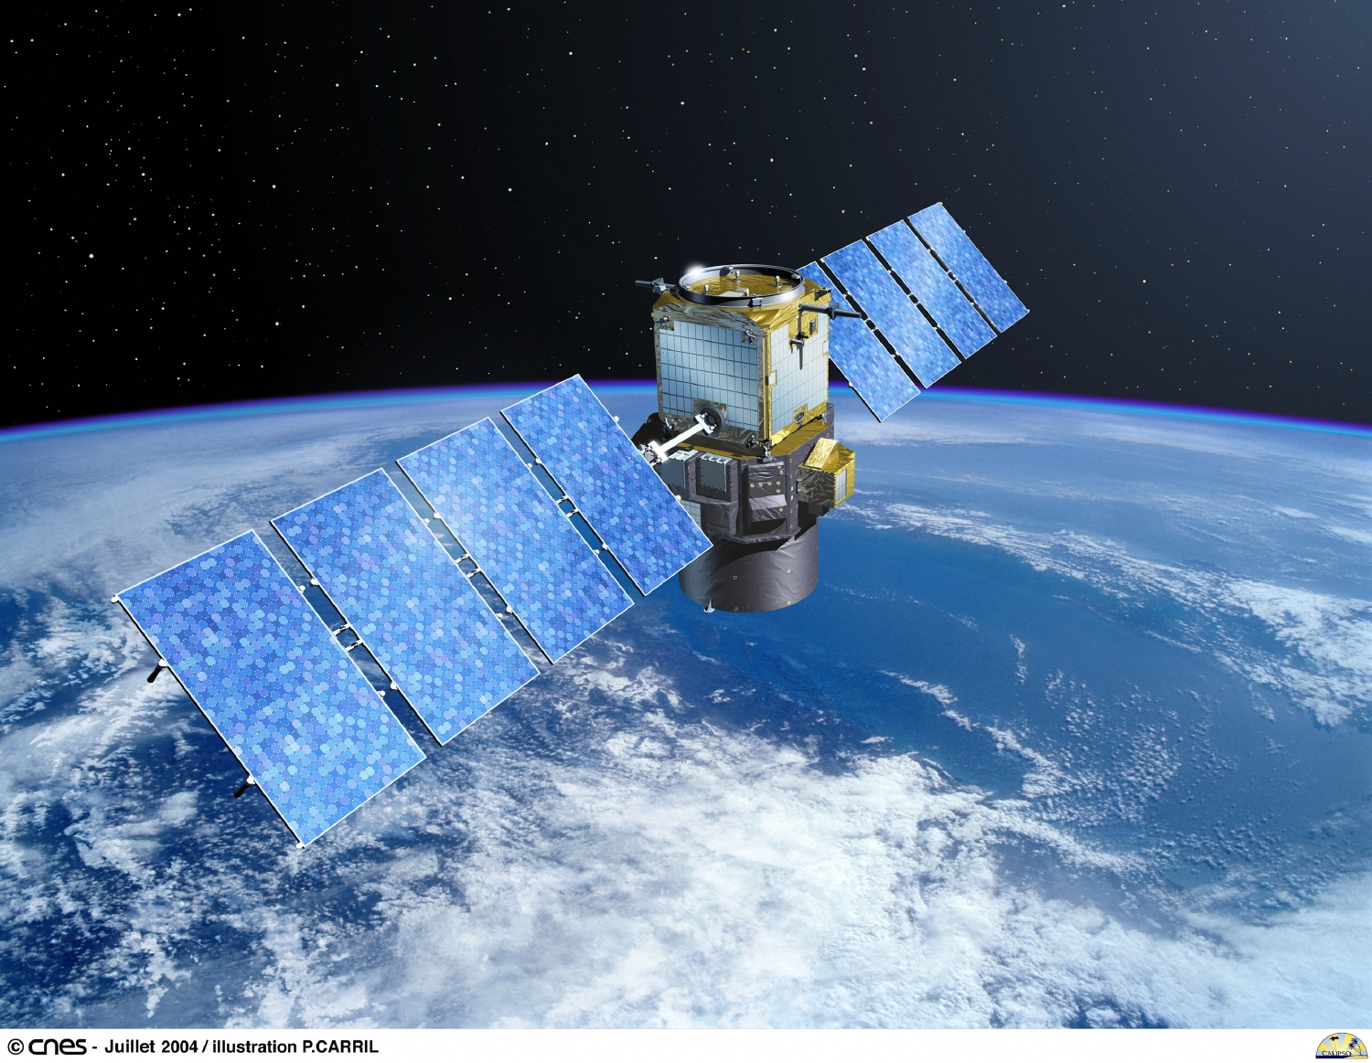
Notes:
6

Slide 6
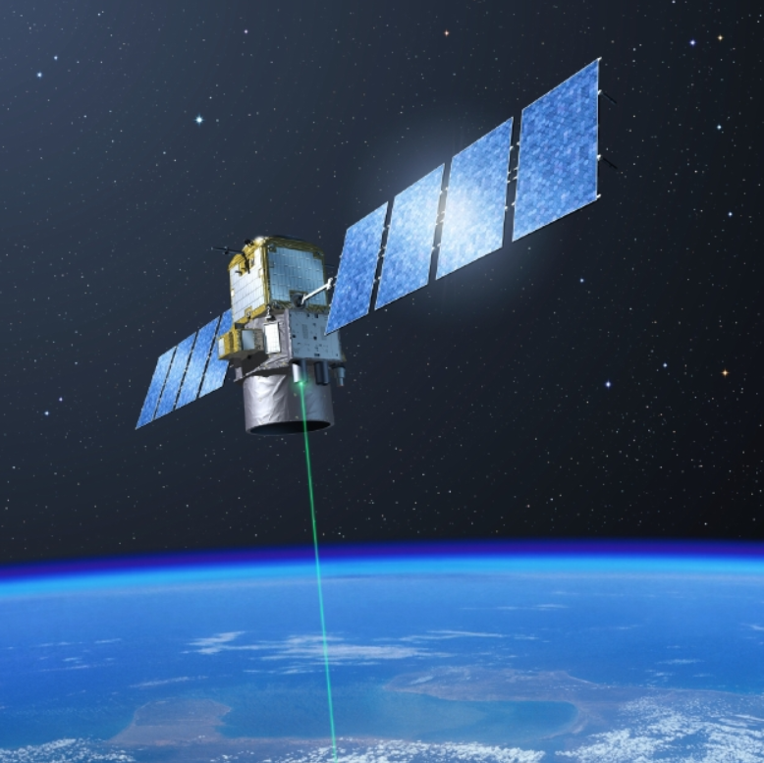
Notes:
8

Slide 7
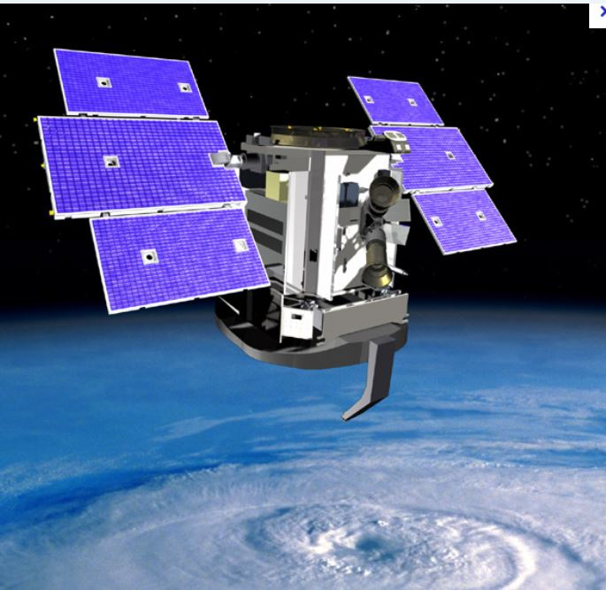
Notes:
5

Slide 8
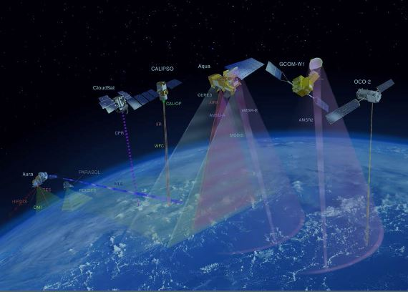
Notes:
7

Slide 9
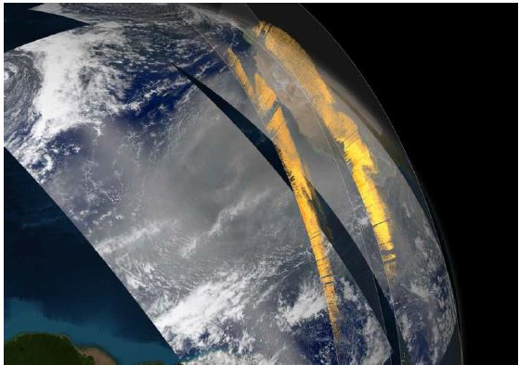
Print resolution still of MODIS imagery showing dust off the coast of Africa on a 3D globe © NASA
Notes:
15

Slide 10
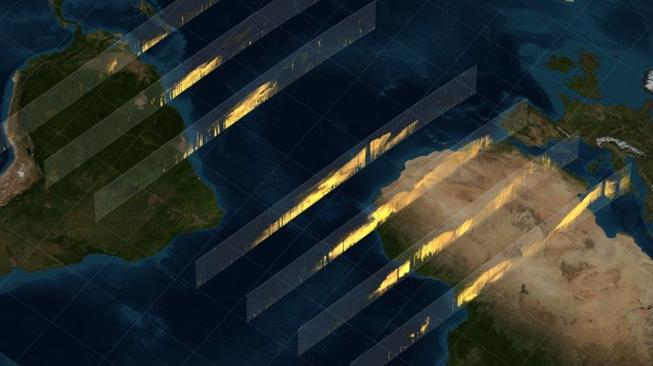
Print resolution still of CALIPSO data curtains depicting dust in the atmosphere, shown in a flat map projection. Each curtain represents one pass of the satellite between 3/16/2010 and 4/2/2010. (The rightmost curtain is 3/16/2010 and the leftmost curtain is 4/2/2010) © NASA
Notes:
16

Slide 11
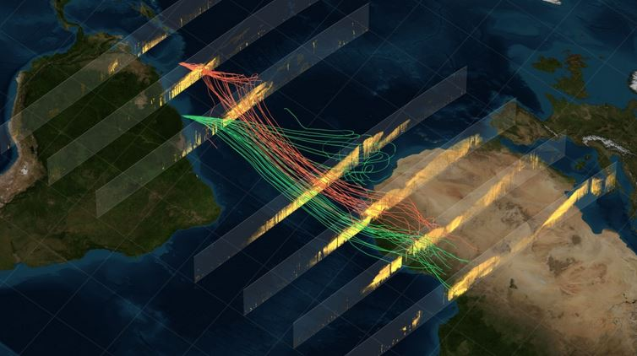
Print resolution still that compares seven days of CALIPSO data (from 3/25/2010 to 4/2/2010) with two sets of back-propagated dust routes over the same period. (NOTE - Routes depict dust that started in Africa and ended in Barbados and Cayenne)
© NASA
Notes:
17

Slide 12
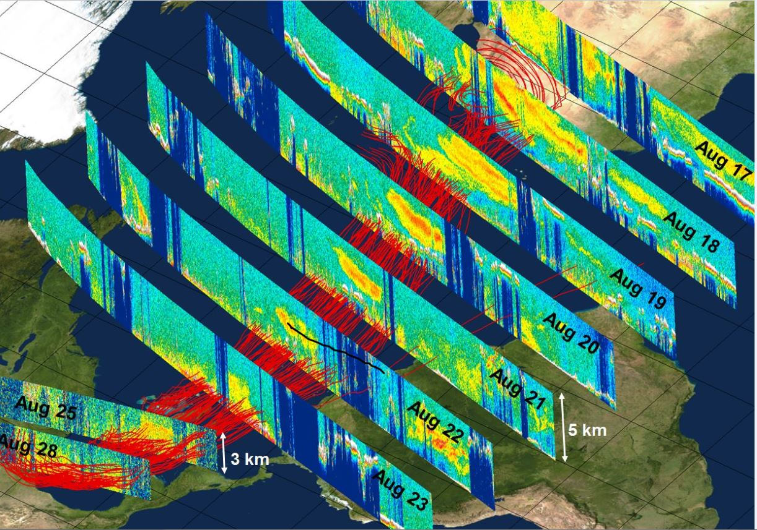
© NASA
Notes:
20

Slide 13
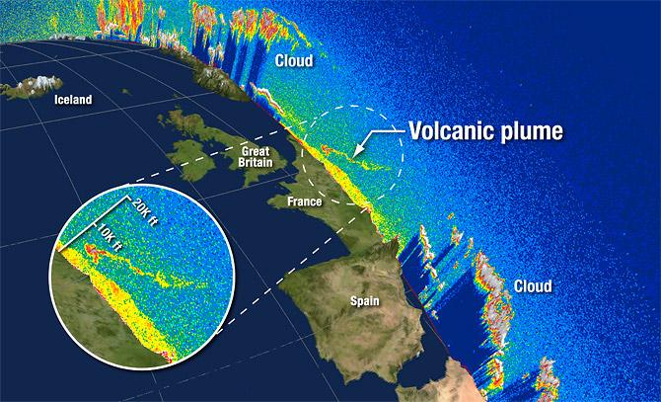
CALIPSO spots ash particles over France on April 17, 2010 © NASA

Slide 14
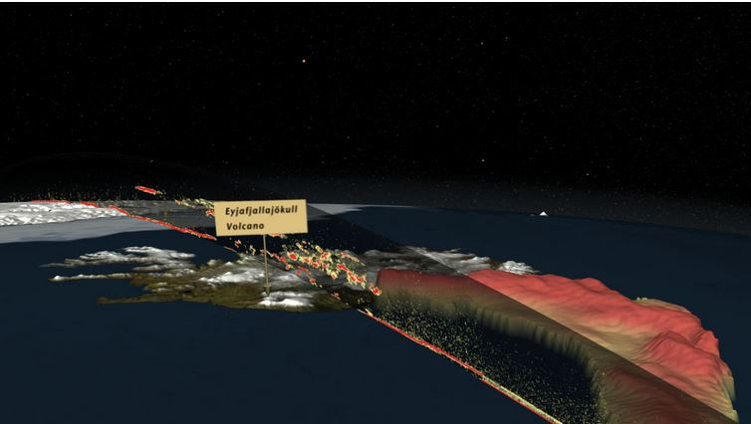
Satellites reveal how Iceland's ice-covered volcano wreaked havoc on Europe © NASA
Notes:
22

Slide 15
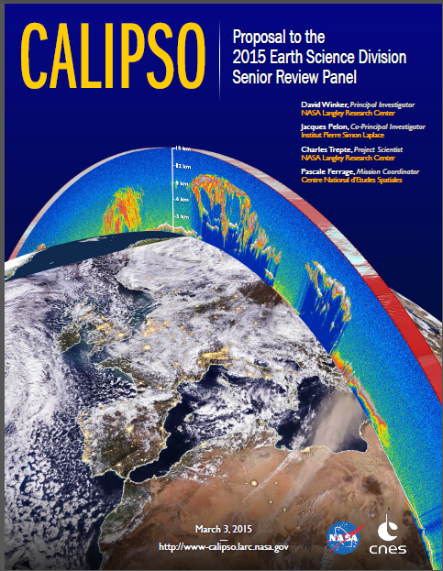
Notes:
10

Slide 16
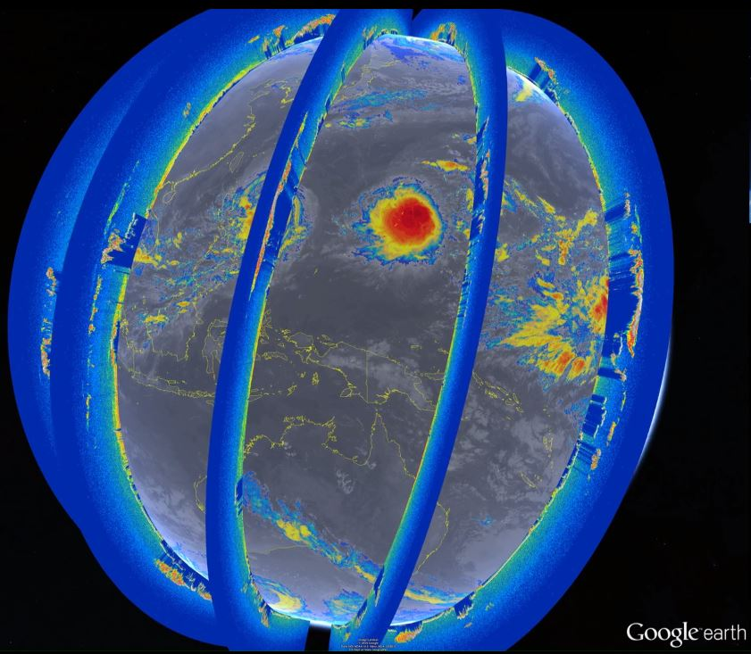
A day viewed by CALIPSO : October 15, 2015 © NASA
Notes:
11

Slide 17
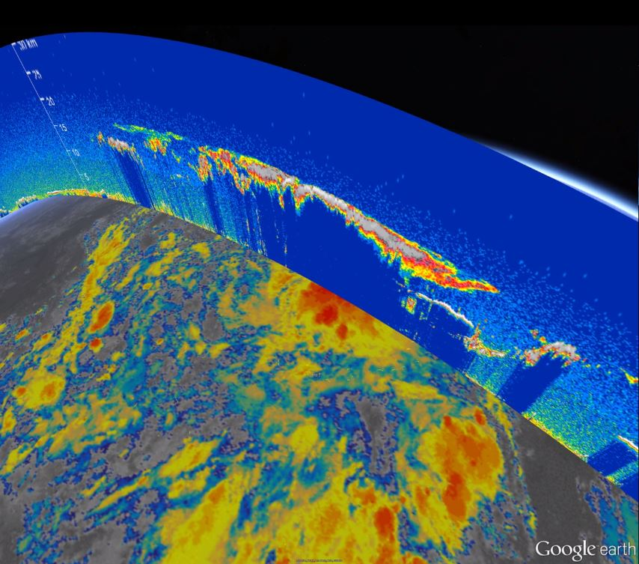
Enzo Warm Pool viewed by CALIPSO / October 15, 2015 © NASA
Notes:
11

Slide 18
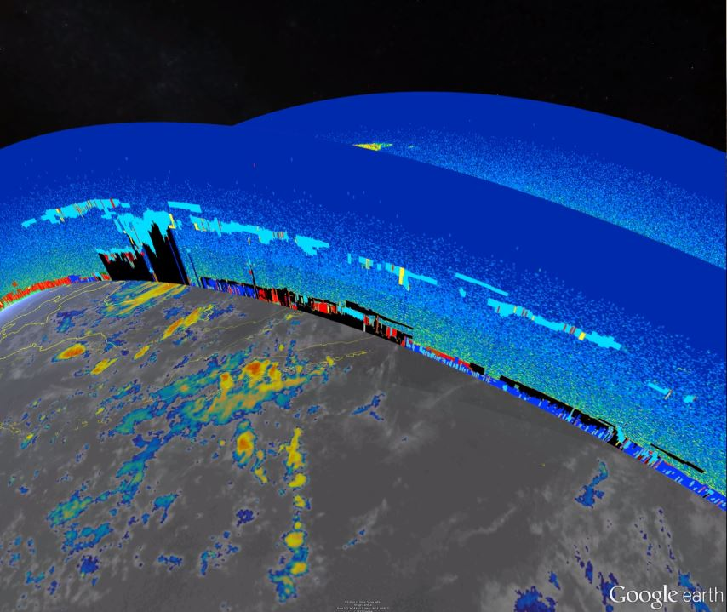
Smoke from Indonesian Forest Fires viewed by Calipso & Cloudsat / October 15, 2015 © NASA
Notes:
11

Slide 19
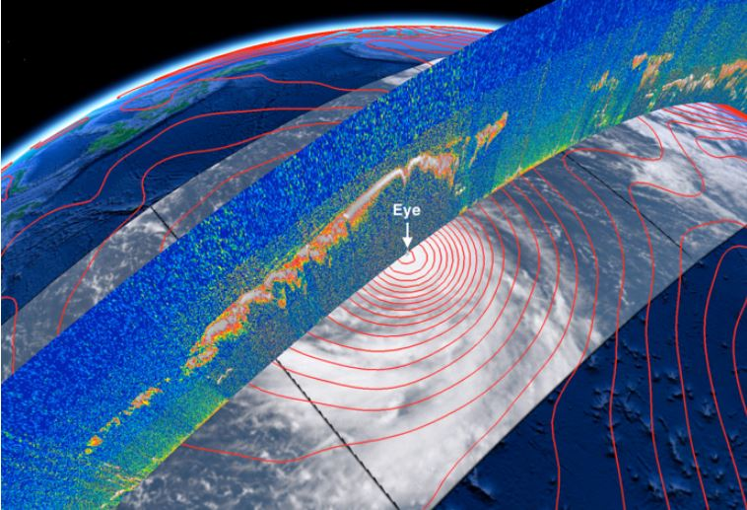
Typhoon Choi-Wan over the western Pacific Ocean © NASA
Notes:
21

Slide 20
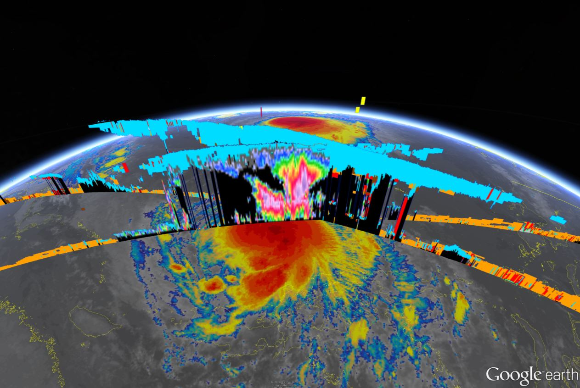
Super Thyphoon Koppu viewed by CALIPSO & CloudSat / October 15, 2015 © NASA
Notes:
12

Slide 21
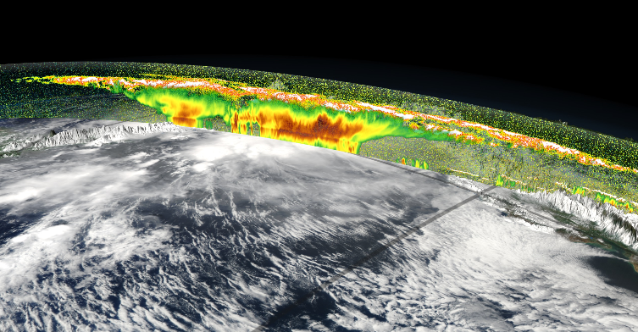
Both CloudSat and CALIPSO detect attributes of clouds on slices through the atmosphere. Here both are shown over an image of MODIS reflectance which is mapped onto the terrain. © NASA
Notes:
13

Slide 22
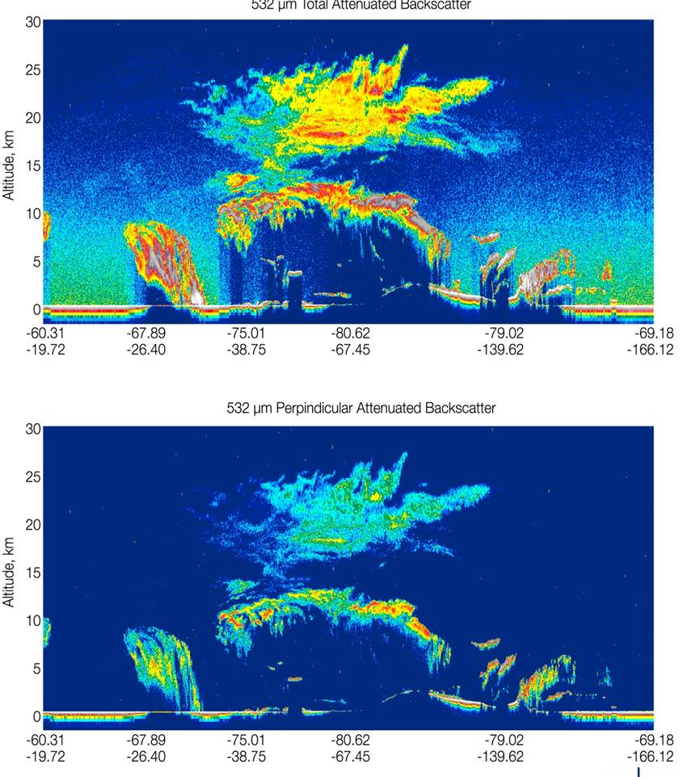
Notes:
18

Slide 23
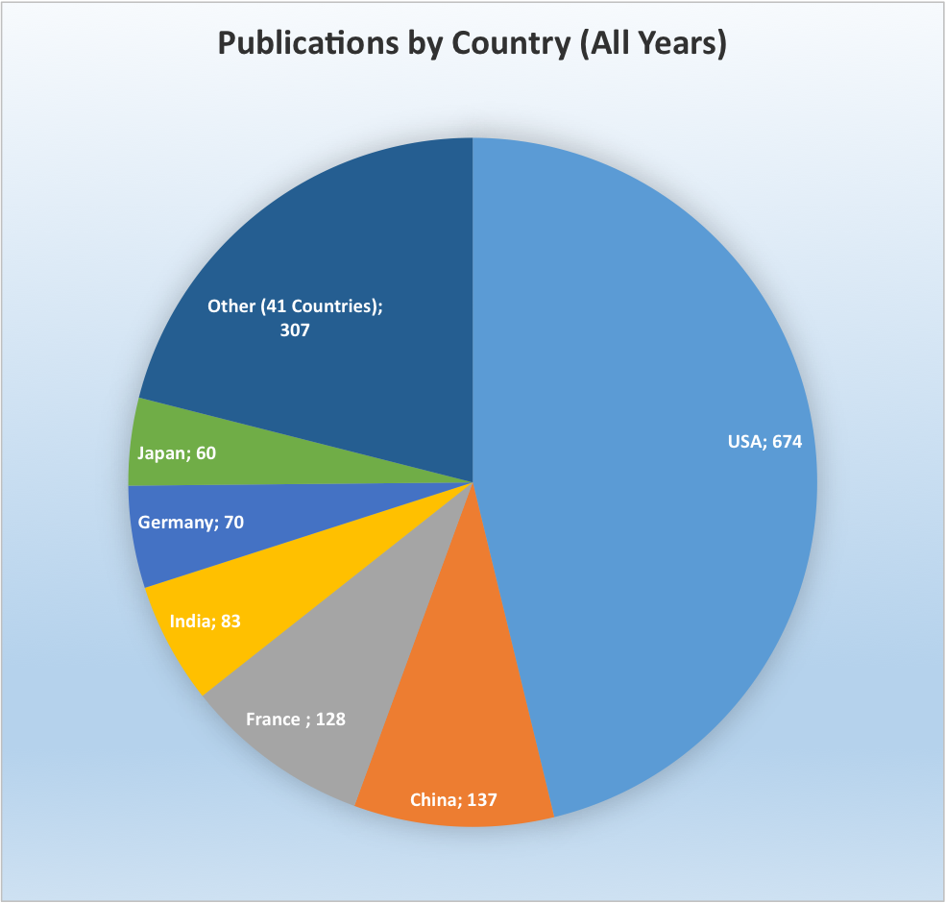
CALIPSO STATISTICS
Publications by country

Slide 24
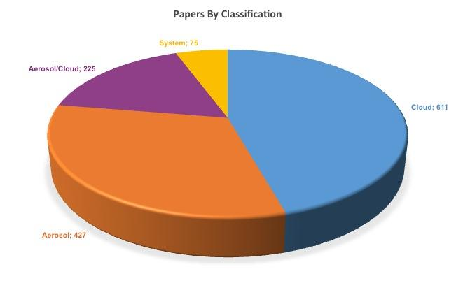
CALIPSO STATISTICS
Papers by Classification

Slide 25
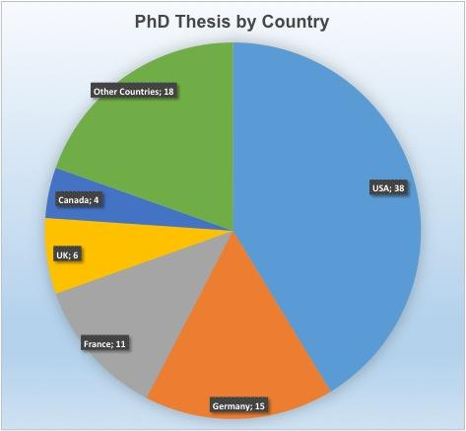
CALIPSO STATISTICS
PhD Thesis by Country

Slide 26
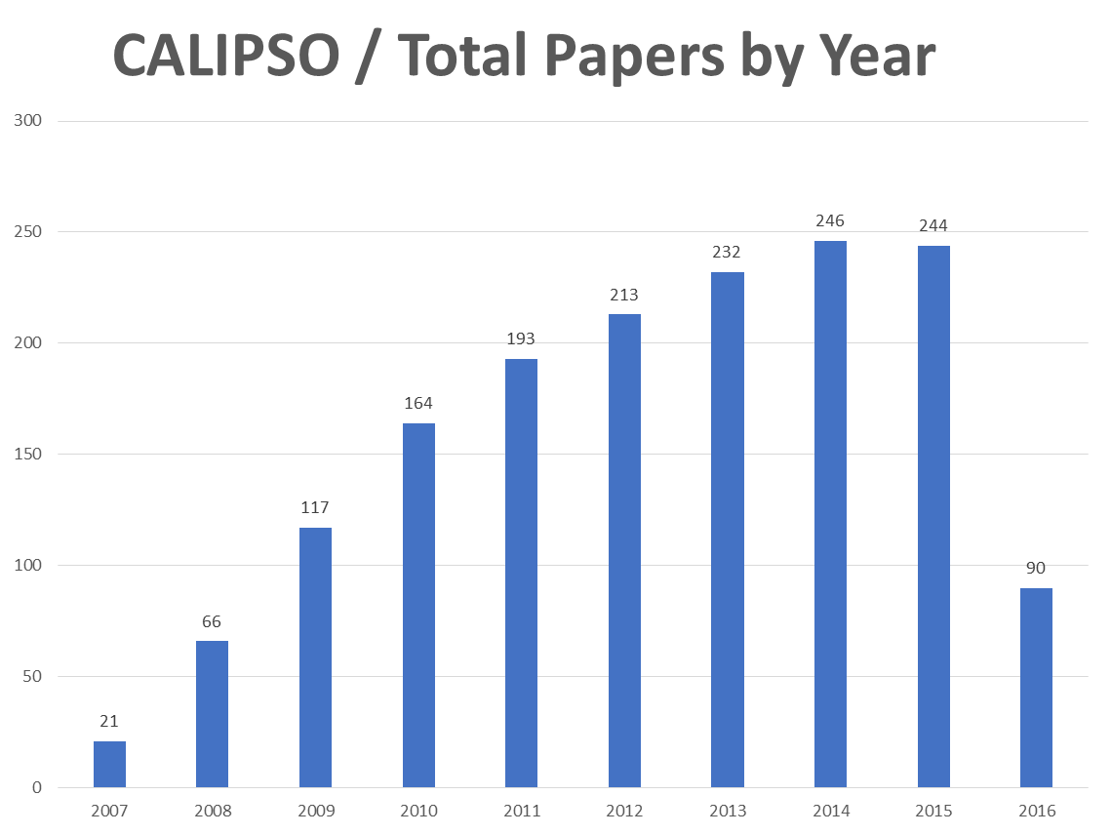
CALIPSO STATISTICS
Total Papers by Year

Slide 27
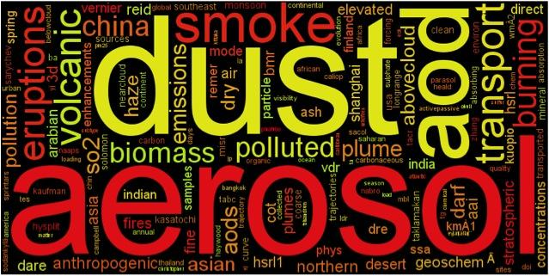
CALIPSO STATISTICS
Frequently Used Words in Aerosol Papers

Slide 28
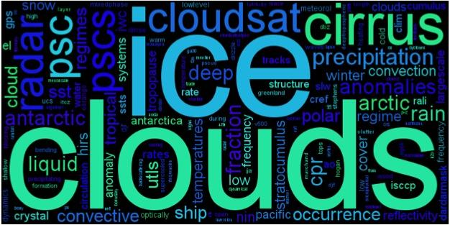
CALIPSO STATISTICS
Frequently Used Words in Cloud Papers

Slide 29
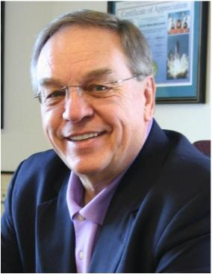
Dr. Gérard Mégie
Dr. M. Patrick McCormick

